Slide 1
§6 Applications of Depth-First Search
/* a generalization of preorder traversal */
void DFS ( Vertex V ) /* this is only a template */
{ visited[ V ] = true; /* mark this vertex to avoid cycles */
for ( each W adjacent to V )
if ( !visited[ W ] )
DFS( W );
} /* T = O( |E| + |V| ) as long as adjacency lists are used */
1. Undirected Graphs
DFS ( 0 )
void ListComponents ( Graph G )
{ for ( each V in G )
if ( !visited[ V ] ) {
DFS( V );
printf(“\n“);
}
}
0
1
2
3
7
4
5
0 1 4 6 5 2 3
7 8
6
8
1/6

Slide 2

§6 Applications of Depth-First Search
2. Biconnectivity
 v is an articulation point if G’ = DeleteVertex( G, v ) has at least 2 connected components.


 G is a biconnected graph if G is connected and has no articulation points.
Biconnected
graph
Articulation
point

 A biconnected component is a maximal biconnected subgraph.
〖Example〗


0
8
9
0
8
9
1
7
7
Note: No edges can be shared by two or more biconnected components. Hence E(G) is partitioned by the biconnected components of G.
1
7
1
7
2
3
5
2
3
3
5
5
4
6
4
6
Connected graph
Biconnected components
2/6

Slide 3
§6 Applications of Depth-First Search
Finding the biconnected components of a connected undirected G
➢ Use depth first search to obtain a spanning tree of G
DFS ( 3 )
Depth first spanning tree
0
Depth first
number (Num)
0
4
9
8
9
8
Back edges
::= (u, v) ∉ tree
and u (or v) is
an ancestor of
v (or u).
3
3
Note: If u is an ancestor of v, then Num( u ) < Num( v ).
1
7
4
1
5
5
7
2
0
5
2
3
5
2
2
6
6
4
6
1
3
7
7
1
6
0
4
8
9
8
9
➢ Find the articulation points in G
 The root is an articulation point iff it has at least 2 children
 Any other vertex u is an articulation point iff u has at least 1 child, and it is impossible to move down at least 1 step and then jump up to u’s ancestor.
3/6

Slide 4
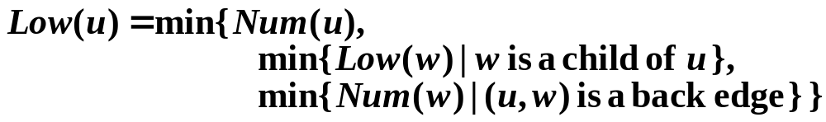
§6 Applications of Depth-First Search
0
3
4
1
5
5
2
2
6
6
vertex
0
1
2
3
4
5
6
7
8
9
Num
4
3
2
0
1
5
6
7
9
8
1
3
7
7
Low
4
0
0
0
0
5
5
5
9
8
0
4
8
9
8
9
Therefore, u is an articulation point iff
(1) u is the root and has at least 2 children; or
(2) u is not the root, and has at least 1 child such that Low( child ) ≥ Num( u ).
Please read the pseudocodes on p.327 and p.329 for more details.
4/6

Slide 5

3. Euler Circuits
§6 Applications of Depth-First Search
Draw each line exactly once without lifting your pen from the paper – Euler tour
Draw each line exactly once without lifting your pen from the paper, AND finish at the starting point – Euler curcuit
〖Proposition〗 An Euler circuit is possible only if the graph is connected and each vertex has an even degree.
〖Proposition〗 An Euler tour is possible if there are exactly two vertices having odd degree. One must start at one of the odd-degree vertices.
5/6

Slide 6
§6 Applications of Depth-First Search
DFS
1
2
3
4
5
6
7
8
9
10
11
12
Note:
The path should be maintained as a linked list.
For each adjacency list, maintain a pointer to the last edge scanned.
T = O( |E| + |V| )
Find a simple cycle in an undirected graph that visits every vertex – Hamilton cycle
6/6

